Slide 1
INVENTORY MANAGEMENT

Slide 2

Course Structure
Overview
Inbound Materials
Internal Movements
Quality Management
Inventory Controlling Reports

Slide 3
overview

Slide 4
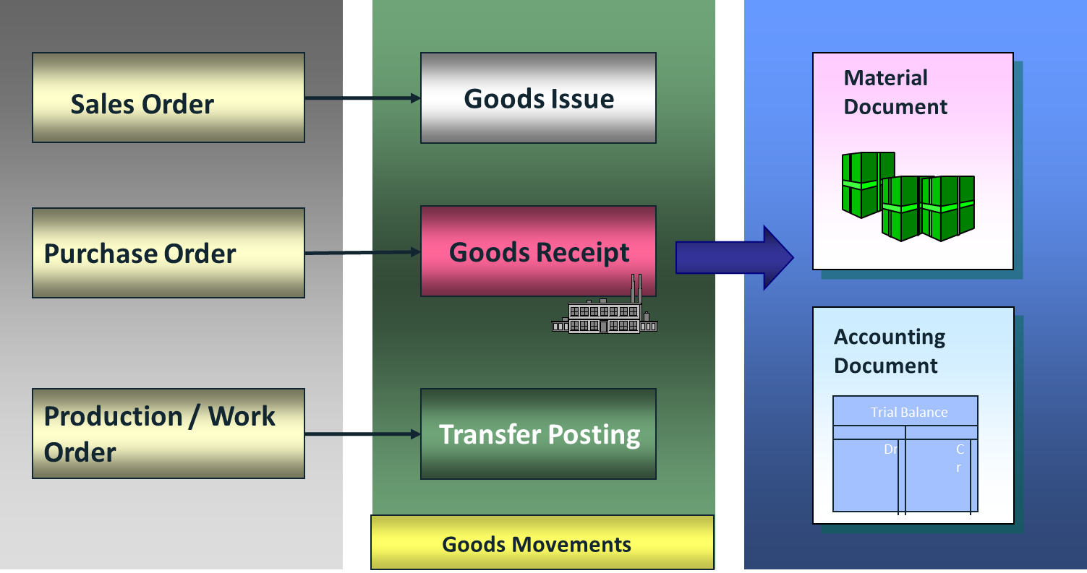
What is goods movement?
Goods Movement is a transaction resulting a change in the stock
Goods Receipt (GR) GR is the receipt of goods from a vendor or from production order. A goods receipt leads to an increase in the stock
Goods Issue (GI) GI is the material withdrawal or material issue, a material consumption, or a shipment of goods to a customer. A goods issue leads to a reduction in the stock
Stock Transfer A stock transfer is the removal of material from one storage location to another storage location. Stock transfers can occur either within the same plant/company code or between two plants/company codes
Transfer Posting A transfer posting is a general term for stock transfers and changes in stock type or stock category of a material. It is irrelevant whether the posting occurs together with a physical movement or not. Examples of transfer postings are:
Transfer postings from material to material
Release from quality inspection stock
Transfer of consignment material into company's own stock

Slide 5
Movement types
SAP Good Movement Types is 3 digital character key which differentiates various material movements, e.g. Goods Receipt, Goods Issue or Transfer Posting.
SAP movement types has controlling functionality in SAP. They play the main role in account determination as well.
SAP movement types also control the screen of the MIGO transaction. Every movement type has a specific automatic set of screens behind. So, when you use different SAP movement types, different types of screens appear in the transaction MIGO.
SAP movement types can be used with a Special Stock Indicator. For example, in Consignment Order, we use the movement type 201 with a special indicator K for consignment to perform goods issue to a cost center. It is also a classification key indicating the type of material movement (for example, goods receipt, goods issue, physical stock transfer).
If the purchase order or order has not been assigned to an account, a stock type (unrestricted-use stock, stock in quality inspection, blocked stock) can be entered during goods receipt.
If the purchase order or order has been assigned to an account, the goods receipt is not posted to the warehouse, but to consumption.
In the case of non-valuated materials, the goods receipt is posted to the warehouse, although the purchase order has not been assigned to an account.
Movement types used with MB* transactions have not changed; same movement types remained unchanged in MIGO with the same control functions; except one new movement type 109 (ZZ9 for Brazil) Goods receipt from valuated GR blocked stock used for the new process STI (Stock In Transit) in Inter Company sales process

Slide 6
Classification of Movement Types
1xx GR from Purchasing/Production and Returns
2xx GI for Consumption
3xx, 4xx Transfers
5xx GR without reference to PO (and for scrapping)
6xx Shipment
7xx Physical Inventory
8xx For Brazil
9xx, Zxx, Yxx, Xxx Customer range 9XX’ range is reserved for custom-developed movement types, so, they can serve different purposes in different SAP configurations

Slide 7
Organizational Level in S/4HANA - Finance​
JTI S/4HANA System
(PRD Client 900)
A client is a separate unit of SAP with its own set of tables, master data and documents.
Group CoA JTIG is used for group onsolidation purposes.
JTI uses a single 6-digit range Operational CoA (JTIO) for financial postings in S/4. It is assigned to all entities.
Every JTIO is assigned to a JTIG account, and an Alternative account if an entity uses a Country CoA.
Reporting can be done at all levels of CoAs, i.e. by JTIO, JTIG or Country CoA, provided appropriate Financial Statement Versions are created using those accounts.
Group Chart of Account: JTIG
Country CoA
(Alternative Accounts)
Operational CoA: JTIO
Operating Concern 1001
An Operating Concern is the valuation level for Profitability Analysis (CO-PA).
All JTI entities belong to Operating Concern 1001, through company code assignment to controlling area, which is subsequently assigned to this operating concern.
Cost Center Standard Hierarchy:
JTI
Profit Center Standard Hierarchy: JTI
An controlling area represents a closed system used for cost accounting purposes. JTI uses only one controlling area “1000”.
Cost centers (CC) and Profit Centers (PC) are created within a controlling area.
Every Cost Center is assigned to a Profit Center.
The standard hierarchies of CC and PC are tree structures representing all CCs and PCs belonging to a controlling area from a Controlling perspective.
Controlling Area 1000
Company code
2101
JTI Gallaher
Company code
1106
JTI GMBH
Company code
1799
JTI SA
Company code
xxxx
A Company Code is the smallest organizational unit of external accounting for which a complete, self-contained set of accounts can be created.
This includes the entry of all transactions that must be posted and the creation of all items for legal individual financial statements, such as the balance sheet and the profit and loss statement.
All company codes in JTI is assigned to the same controlling area and use the same operational CoA.

Slide 8
Organizational Level in S/4HANA - Logistics
JTI S/4HANA System
(PRD Client 900)
A client is a separate unit of SAP with its own set of tables, master data and documents.
A Company Code is the smallest organizational unit of external accounting for which a complete, self-contained set of accounts can be created.
In order to carry out logistic processes, company codes need to be linked to purchasing and sales organizational units in SAP.
A purchase organization is assigned to a company code.
A sales organization is assigned to a company code.
Company Code
1106
Company Code
XXXX
Purchase Organization
DE01
Sales Area
A Purchasing Organization is an organizational unit which procures articles and negotiates general purchase price conditions with vendors . There can be more than one purchase organizations assigned to one company code in JTI.
A Sales Organization that structures the company according to its sales requirements.
Sales
Organization 1106
Plant DEP1
Plant DEA1
A Plant is an organizational unit serving to subdivide an enterprise according to production, procurement, maintenance, and materials planning aspects.
It is a place where either materials are produced or goods and services provided.
The sales area is the combination of a distribution chain (a sales organization and a distribution channel) and a division.
Distribution
Channel 02- Export
Division 01- Cigarette
Storage
Location
Storage
Location
Storage
Location
Storage
Location
Storage locations are the places where stock is physically kept within a plant.
A sales office is an organizational unit in sales and distribution which is responsible for sales within a specific geographical area.
Sales groups are subdivisions of a distribution chain.
Sales office –
ICP Inter co)
Sales group –
ADF (Duty Free)
Shipping Point
A shipping point is a place or location where the goods and services are delivered to the customers”.
Shipping point is an independent organizational unit in SAP SD module and it is responsible for processing inbound and outbound deliveries..

Slide 9
Course Structure
Overview
Inbound Materials
Internal Movements
Quality Management
Inventory Controlling Reports

Slide 10
Inbound Materials Process Flow
Inbound processing reflects the receipt of materials that are delivered to a receiving location. This receipt can be processed based on purchase orders, stock transport orders, or even a returns order.
Receive Goods
Receive NTM
Receive FG Returns
Buy Back FG
Receive Water (Flavor House-EHF)

Slide 11
Receive Batch Managed Goods & NTM
Batch managed materials, e.g. tobacco standard grades, tobacco SFG, SKU FG, SKU SFG, most of the NTMs, should be processed with incoming inspection process steps following goods receipt.
GR Report for Incoming Deliveries
(VL06I, ME80FN)
Delivery Note and other documents received with the delivery
GR against Purchase Order (MIGO; Movement Types 101, 103/105, Z34, 861, 109 for SiT)
Materials arrive
Delivery is checked
Inspection lot is created
Print Pallet Labels (ZMIMA01)
The goods are received into Quality Inspection
Results Recording & Usage Decision (QE51N & QA11)

Slide 12
Receive Non-Batch Managed Goods & NTM
Non-Batch managed materials, e.g. green leaf, spare parts, marketing materials, most of the packaging NTMs, are processed with GR to unrestricted stock without incoming inspection process.
GR Report for Incoming Deliveries
(VL06I, ME80FN)
Delivery Note and other documents received with the delivery
GR against Purchase Order and Print GR slip (MIGO)
Materials arrive
Delivery is checked
The goods are received into Unrestricted Stock

Slide 13
Receive FG from Shop Floor
No GR posting is required, as this action is done by the Shop Floor process during confirmation posting.
Transferring FG from Shop Floor to the Warehouse is to be done with MIGO transaction with movement type is 311.
GR into Unrestricted Stock by SF during confirmation posting
Transfer FG to the Warehouse
(MIGO; Movement Type 311)
Print Pallet label – if required
(ZMIMA01)
The goods are received into Warehouse Unrestricted Stock

Slide 14
Receive FG Returns
The process for finish goods returns flow is below
Print GR Report (VL06I)
Check Delivery
Receive Materials
Inform related functions and correct discrepancies
Generate Batch (MSC1N)
Print pallet label (ZMIMA01)
Record Receipt (MIGO; Movement Type 101)

Slide 15
Buy Back FG
The quantity is transferred from stock in quality inspection in the issuing storage location into stock in quality inspection in the receiving storage location.
This posting is to be done with MIGO, movement type is 323.
Record Receipt (MIGO; Movement Type 101)
Fumigate Materials
Transfer Materials to Shop Floor QI stock (MIGO; Movement Type 323)
Send Materials to Reclaim

Slide 16
Course Structure
Overview
Inbound Materials
Internal Movements
Quality Management
Inventory Controlling Reports

Slide 17
Internal Movements Process Flow
Internal Movement process comprises of the preparation of goods to be delivered from a warehouse to a receiving location. Outbound processing starts with an outbound delivery that has been created based on reference documents such as sales orders or stock transport orders.
Outbound Others
Material Disposal
Non-Hazardous Materials
Stock Transfer
Sub-Contracting
Outbound Other (Brazil)

Slide 18
Outbound Others
Outbound process for materials those are not directly related with production requires periodical inventory adjustment.
Consumption movement is to be done with MIGO movement type is 201 GI for Cost Center
MIGO G/L Account Validation Set up (ZM_MIGOGLM)
Read & Record Beginning Inventory daily
Goods Issue posting for consumption (MIGO; Movement Type 201)
Check Material Document List (MB51)

Slide 19
Material Disposal
In this process, majority of the steps are to be performed manually to identify and collect materials for disposal, based on JTI environmental policies, R&D definitions and country specific regulations.
Goods Issue to Cost Center for scrapping is to be done with MIGO, movement types 551/552, Z25 (Specific for Brazil)
Identify Waste
Collect Waste
Determine Disposal Method
Collecting
Selecting for disposal for recycling
Selecting disposal for landfill
Scrap material GI to Cost Center (MIGO; Movement Types 551/552, Z25)
Approval for Disposal and documentation

Slide 20
Non-hazardous Materials
Non-hazardous materials for disposal are to be identified based on JTI environmental policies, R&D manuals and country specific regulations and to be blocked.
Material is blocked with MIGO, movement type 344, and Goods Issue to Cost Center for scrapping is to be done with MIGO, movement type, which is used for issuing materials for scrapping from blocked status
Identify Non-Hazardous Materials for scrapping
Ensure the materials are blocked
(MIGO; Movement Type 344)
Scrap material GI to Cost Center (MIGO; Movement Type 555)
Transfer material to landfill

Slide 21
Stock Transfer between SLocs
Stock Transfer is simply described as the removal of material from one storage location and transfer to another one. One and two step procedures are possible to transfer the materials from SLoc to SLoc; Plant to Plant and between company codes.
Stock transfer in SAP is done at the time of the physical movement of the material.
MIGO is to be used for stock transfer in SAP HANA, by keeping movement type 311.
Physical Transfer of the Materials from one SLoc to another
Record goods movement for Stock Transfer between SLocs
(MIGO; Movement Type 311)

Slide 22
Sub-Contracting
Subcontracting is one of the manufacturing strategy by which a company decides to outsource some or all of its production operations to a vendor.
In a typical subcontracting process, a manufacturing company provides raw materials / components to a subcontracting vendor. The vendor processes these materials to turn them into an end product.
To achieve this, a subcontracting purchase order for the end product is created. The raw materials, which constitute the Bill of Material (BOM) of the end product are then delivered to the subcontracting vendor. The components at the subcontractor's site are managed in a special stock for the vendor. This stock is valuated and available for MRP. It is not allocated to a specific storage location. Finally, a Goods Receipt is posted when the end product is received from the vendor.
In SAP HANA, transfer posting for sub-contracting process is to be done with MIGO, movement type 541 (941/Z91). With this movement type subcontractor is provided with the components required for subcontract orders. The quantity is posted into unrestricted-use stock of material provided to vendor. MIGO Transfer Posting, movement type 542 (942/Z92/Z93) is used to return component from the vendor back to the manufacturing location
PO for subcontracting is issued
Provide components to subcontracting vendor
(MIGO; Movement Type 541)
Return components to the stock from subcontracting vendor
(MIGO; Movement Type 542)

Slide 23
Course Structure
Overview
Inbound Materials
Internal Movements
Quality Management
Inventory Controlling Reports

Slide 24


Quality Inspection – Batch Managed Materials
Material needs to
be checked by
quality
Material Posting from
Unrestricted to Quality
(Automatic 321)
Inspection Lot is Created
Lot Origin 08 – Stock Transfer
Results Recording Worklist (QE51N)
Results Recording
(QE51N)
2. Usage Decision
(QA11)
Quality Inspection
is Performed
Record Usage Decision
Release/Block Material

Slide 25
Shelf Life Expiration & Recurring Inspection
Shelf life
has expired
(Automatic nightly batch QA07)
1. Run Stock Aging Report (MB5M)
2. Check Batch
(BMBC)
Results Recording Worklist Shelf Life (QE51N)
Inspection Lot Origin 09 – Recurring Inspection
1. Results Recording
(QE51N)
2. Usage Decision
(QA11)
Shelf life extended?
YES
NO
Review/ change
next
inspection
date
(MSC2N)
Materials disposal
Inspection Lot is created
Material moved in QI

Slide 26

Shelf Life Inspection
Inspection Lot is Not Created
Batch is Restricted
Deadline Monitoring of
Batches
QA07
(Nightly Background Job)
Inspection Lot is Created
Batch is in Quality Inspection
Next Inspection Date

Slide 27
Recurring Inspection
Results Recording Worklist Shelf Life (QE51N)
Inspection Lot Origin 09 – Recurring Inspection
Inspection Lot is Created
Batch is in Quality Inspection
Worklist
Results Recording
(QE51N)
Worklist
2. Usage Decision
(QA11)
Quality Inspection
is Performed.
Next Inspection Date
Is Changed.
Record Usage Decision
Release/Block Material

Slide 28
Course Structure
Overview
Inbound Materials
Internal Movements
Quality Management
Inventory Controlling Reports

Slide 29
Available Fiori apps and Mapping with S4H
Material Inventory Values
MC.1 and MC.48
Goods Movements Analysis
MC.2, MC50, MC45, MCBC, and MCBA
Inventory Turnover Analysis
MC.B, MC.C
Slow- or Non-Moving Materials
MC46
Stock Multiple materials
Overview Inventory Management
MC.1 and MC.48
Inventory Report
ZCP06

Slide 30
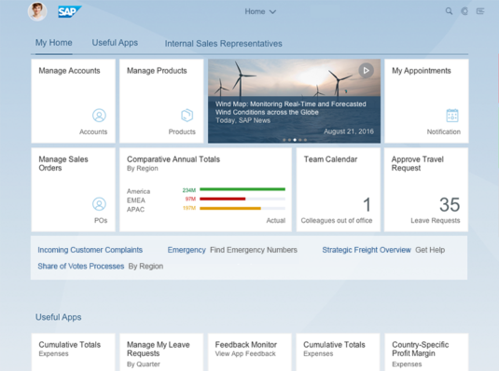
SAP Fiori – Overview
SAP Fiori launchpad is a shell that hosts SAP Fiori apps, and provides the apps with services such as navigation, personalization, embedded support, and application configuration.
SAP Fiori launchpad is the single entry point to SAP Fiori apps; is role-based, displaying tiles according to the user’s role
The primary place where a user will look for applications is the home page. This is the heart of the launchpad and the starting place for the user after logging in. It is the main entry point to SAP Fiori apps
The launchpad home page displays tiles and links that allow the user to launch apps, and may also show additional information. The page can be personalized and apps can be added, removed, or bundled in groups

Slide 31
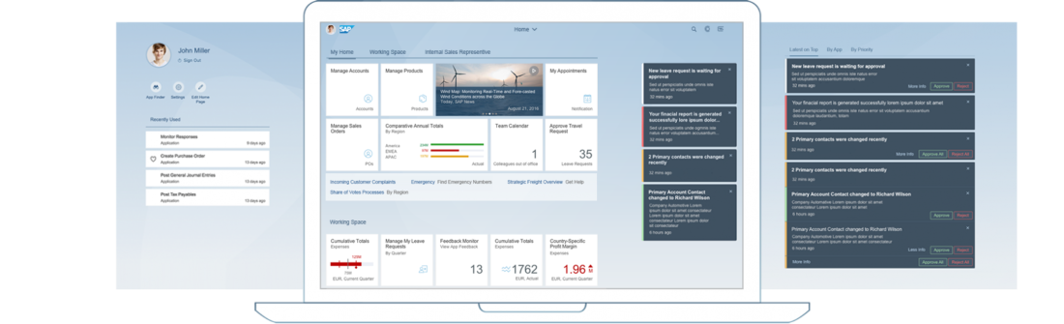
SAP Fiori – Viewport
SAP Fiori consists of 3 main views: HOME Page, ME Area and Notifications
The viewport represents a partial view of a larger surface, and is the entry point for the users’ daily business
This surface is used to offer additional space for user-specific and system-driven data
It allows users to focus on their daily work and still keep track of what’s going on in other areas
The viewport provides possibilities to integrate different areas through the Me Area and notifications
Me Area
Accessed by clicking on the profile image; includes settings and user preferences
Home Page
The starting place where a user looks for applications
Notifications
It’s an optional function and not activated for JTI

Slide 32
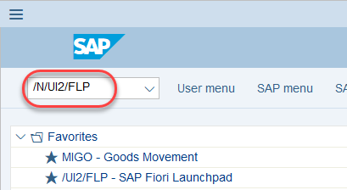
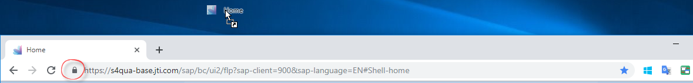
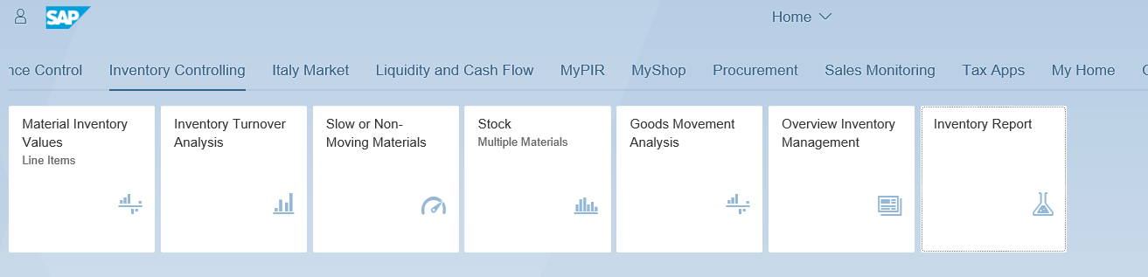
How to Access
Open SAP and type /N/UI2/FLP into the command bar and press enter
Fiori launchpad will be opened in Internet Explorer
It is possible to create a short-cut on the desktop (hold the icon shown in the picture, drag to the desktop and drop)
All new Fiori Apps are accessible under Inventory Controlling Group in Fiori Launchpad
Any apps can be launched by clicking on the respective tile

